Slide 1
Protein digest
Bioinformatics computing

Slide 2
How well does the program meet the requirements?
Write a simple web-server application using TurboGears to carry out an in silico enzymatic digest of a user-provided protein sequence.
Users should be able to specify min and max length, min and max molecular weight, # of missed cleavages, and specific enzyme.
Output should be a table of peptides, with their length, molecular weight, # of missed cleavages, and amino-acids to left and right of each peptide in the protein sequence.

Slide 3
SCIENTIFIC TRADEOFFS
- Parses all cleavage rules correctly but only does C terminal exceptions as of current
- only select enzymes
-Most difficulty came from exceptions

Slide 4
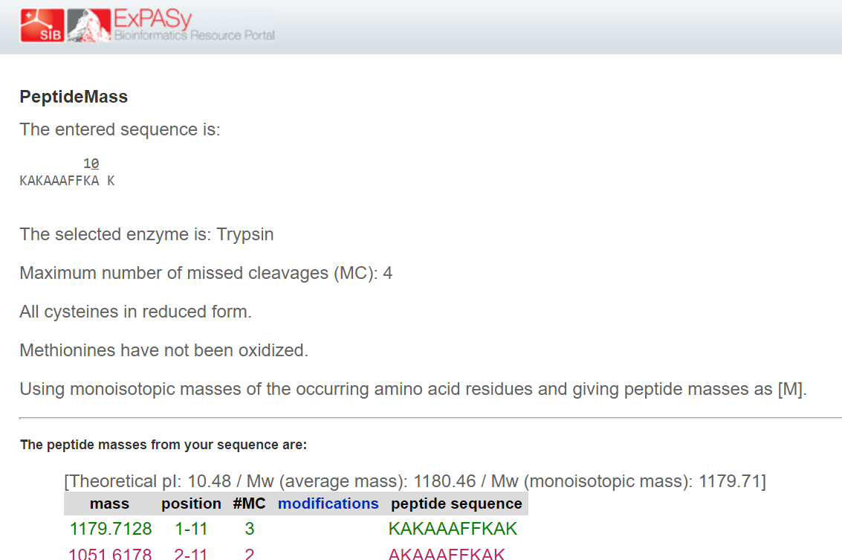
TESTING
Asked for random people to fill out form to see if it would work

Slide 5
conclusion
What I learned about bioinformatics + programming
- individual enzymes can have special individual rules (like Trypsin (specific))
The hard part of programming is anticipating errors
Turbo gears helped me see some connection between programming languages – Python/HTML/CSS
I had hoped to do all of the enzymes and more webpage design but couldn’t figure out logistics in time
rewrite/trim down code

